Slide 1
FEBRUARY 6 - 9, 2023

Slide 2



Slide 3
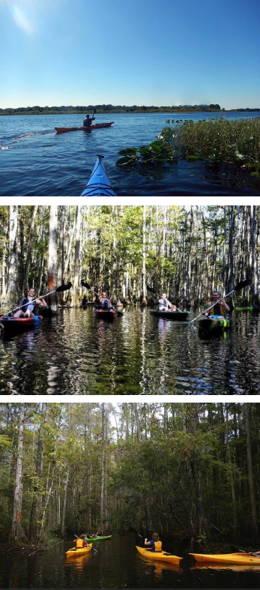


Slide 4
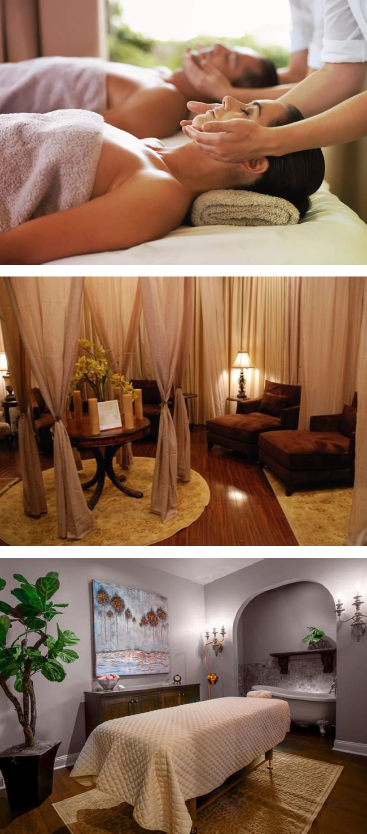


Slide 5
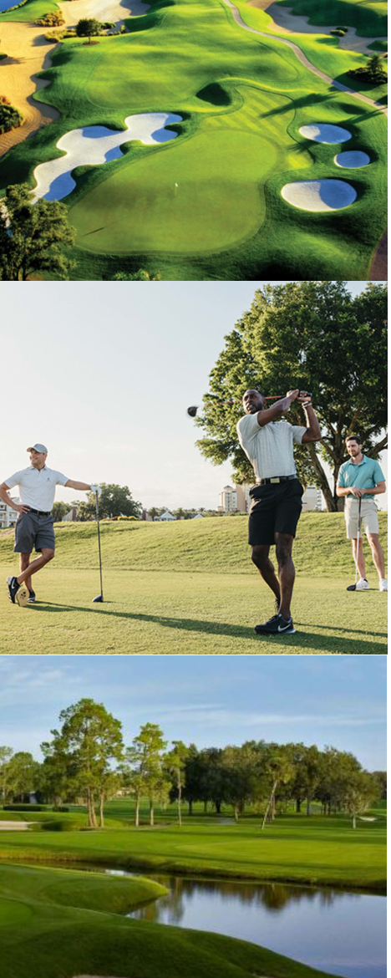
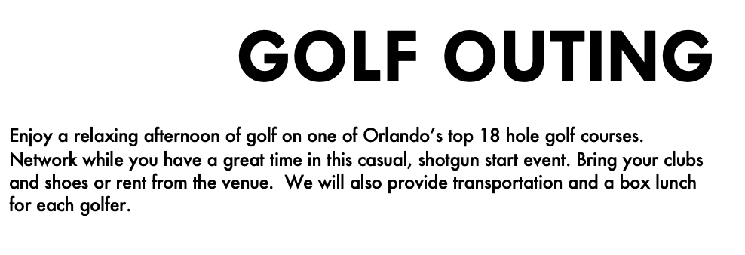

Slide 6


Slide 7


Slide 8


