Slide 1
Caribe Royale
Orlando, FL | February 2-5

Slide 2
GuidePoint Security
CKO 2026
“
This event was incredibly well executed—from the thoughtfully chosen location to the ample time carved out for networking. The communication was seamless and the energy was high.
Our partners play a pivotal role in this journey—and our CKO is where those partnerships deepen, evolve, and take off.
”
Copyright ©2025 | guidepointsecurity.com
2

Slide 3

What Makes CKO
Different
CKO 2026 is more than an internal event—it’s a launchpad.
Exclusive Vendor Sponsorship Opportunities Include:
Direct Access to GPS key decision-makers, technical leads, and sales influencers
Tailored Messaging Support to help refine and target your value to GPS teams
Deepen collaboration on how to jointly serve clients better
Curated Engagement Moments for maximum visibility and connection
“
Great opportunity to engage with GuidePoint leadership, deepen partnerships, and build meaningful visibility with both sellers and engineers.
”
Let’s make 2026 your highest-ROI engagement yet.
Copyright ©2025 | guidepointsecurity.com
3

Slide 4
CKO Code of Conduct
CKO CODE OF CONDUCT AGREEMENT: To register for CKO each person will need to agree to our CKO Code of Conduct during the registration process.
EXPECTED BEHAVIOR: All CKO participants are expected to behave in accordance with professional standards, this Code of Conduct and GuidePoint’s policies governing appropriate workplace behavior and applicable laws.
UNACCEPTABLE BEHAVIOR: Unacceptable behavior from any CKO participant will not be tolerated. Unacceptable behavior includes, but is not limited to:
Intimidating, harassing, abusive, discriminatory, derogatory, or demeaning speech, materials, or conduct by any Participants of the event and related event activities. The event venue is shared with members of the public; please be respectful to all patrons.
Violence, threats of violence, or violent language directed against another person.
Sexist, racist, homophobic, transphobic, or otherwise discriminatory jokes and language.
Personal insults, particularly those related to gender, sexual orientation, race, religion, or disability.
Inappropriate photography or recording.
Any boisterous, lewd, or offensive behavior or language, including but not limited to using sexually explicit or offensive language, materials or conduct, or any language, behavior, or content that contains profanity, obscene gestures, or racial, religious, or ethnic slurs.
Failure to obey any rules or regulations of the event venue.
CONSEQUENCES OF UNACCEPTABLE BEHAVIOR: If a participant engages in unacceptable behavior, whether in person or virtually, GuidePoint may take any action they deem appropriate depending on the circumstances, ranging from issuance of a warning to the offending individual to termination. GuidePoint reserves the right to exclude any attendee found to be engaging in harassing behavior from participating in any further events, trainings, or other activities, and may be sent home if necessary. If a participant, through postings on social media or other online publications or another form of electronic communication, engages in conduct that violates this policy, whether before, during or after CKO, GuidePoint may take appropriate corrective action.
WHAT TO DO IF YOU WITNESS OR ARE SUBJECT TO UNACCEPTABLE BEHAVIOR: If you are being harassed, notice that someone else is being harassed, or have any other concerns relating to harassment, contact HR staff immediately.
CONTACT: Meghan.mayer@guidepointsecurity.com

Slide 5
What’s NEW?
NEW Wednesday Sales & Technical Team Outing*
Title, Diamond, Platinum, Gold & Tiger Cage Sponsors
Dedicated time with entire sales & technical organization
Casual outdoor networking event with music, games, and food trucks
“
As a first-time attendee, I finally understand why there’s so much enthusiasm about GPS CKO. It’s not the venue or the agenda that sets it apart—it’s the incredible people behind it. The passion and authenticity of the GPS team made a lasting impression.
*This outing replaces excursions
OPTIMIZED Agenda Format
Regional Outings moved to Monday
Vendor showcase moved to Tuesday
Silver activities start & end on Tuesday
”
Copyright ©2025 | guidepointsecurity.com
5

Slide 6
Agenda at a Glance*
Day 1
Monday, February 2
Day 2
Tuesday, February 3
Day 3
Wednesday, February 4
6:30am
Vendor Showcase Setup Starts
8:00am
GPS 2026 Outlook Keynote
9:00am - 12:00pm
Sales Training,
Sponsored Engineering Trainings & Tiger Cage Presentation
9:00am
Sponsor Executive Meetings Title, Diamond, Platinum,
Tiger Cage
9:15am
External Keynote Session
11:00am
Title Sponsor Presentation:
Title Sponsor Only
12:00pm
VIP Executive Lunch Title, Diamond, Platinum, Tiger Cage
3:00pm
Vendor Showcase Setup Ends
3:30 - 6:00pm
Vendor Showcase
Silver activities end after Showcase
3:30pm
Sales & Technical Block Party Title, Diamond, Platinum, Gold, Tiger Cage
VIP Executive Welcome Reception – Title, Diamond, Platinum, Tiger Cage
4:30pm
7:00pm
End of official event programming
6:30pm
Regional Outings
Title, Diamond, Platinum, Gold, Tiger Cage
7:30pm
All Company Party
*Gold + Sponsors Only
Copyright ©2025 | guidepointsecurity.com
*Times all subject to change 6

Slide 7
Sponsorship Overview

Slide 8


Sponsorship Packages for GuidePoint Security CKO 2026
Invite Only
Invite Only
Invite Only
Limited Inventory
Limited Inventory
Title
Diamond
Platinum
Gold
Silver
Early Bird Pricing
Contract Deadline
October 31, 2025
$80K
$65K
No Early Bird Pricing
$75K
$50K
Standard Pricing
Contract Deadline
January 2, 2026
$85K
$80K
$70K
$55K
$25K
Sponsor Showcase Participation (Tabletop exhibit)
Sponsor Showcase Premier Location
Exhibit & Meeting Space
Sponsor Lounge – Meeting & Networking
Executive Meeting
Engineering Breakout Session
Copyright ©2025 | guidepointsecurity.com
8
Notes:
https://docs.google.com/spreadsheets/d/1Tf260sS9bCDN7xs3y0dZRTf1sENjlSNd/edit?usp=sharing&ouid=107982667786969419961&rtpof=true&sd=true

Slide 9
Sponsorship Packages for GuidePoint Security CKO 2026
Invite Only
Invite Only
Invite Only
Limited Inventory
Limited Inventory
Title
Diamond
Platinum
Gold
Silver
Attend/ Network
CKO Attendance Passes
12
10
8
6
3
VIP Executive Lunch – Monday
6
4
2
Exclusive VIP Welcome Reception – Monday
6
4
2
Attend Tuesday Keynotes
Regional Outings
2 attendees for each event
ALL Regions
ALL Regions
ALL Regions
2 Regions
NEW Wednesday Sales & Technical Team Outing
2 Passes
2 Passes
2 Passes
2 Passes
Opportunity to Purchase Additional Attendee Passes
Up to 10
Up to 8
Up to 6
Up to 4
Opportunity to Purchase Additional Marketing Add-Ons
Attend VRM Insights Session: Accelerating GPS Engagement
Copyright ©2025 | guidepointsecurity.com
9
Notes:
https://docs.google.com/spreadsheets/d/1Tf260sS9bCDN7xs3y0dZRTf1sENjlSNd/edit?usp=sharing&ouid=107982667786969419961&rtpof=true&sd=true

Slide 10

Sponsorship Packages for GuidePoint Security CKO 2026
Invite Only
Invite Only
Invite Only
Limited Inventory
Limited Inventory
Title
Diamond
Platinum
Gold
Silver
Speaking Opportunities
General Session Presentation - 45 Minutes
General Session Shout Out
Sales Presentation - 20 Minutes
On-Site Branding
Premier On-site Branding
On-site Signage Inclusion
Mobile App Recognition
Hallway/Pavilion Branding
Mobile App Push Notification(s)
2
1
Pre/Post Branding
CKO Employee Website Brand Recognition
Full Attendee List Post-Event
Copyright ©2025 | guidepointsecurity.com
10
Notes:
https://docs.google.com/spreadsheets/d/1Tf260sS9bCDN7xs3y0dZRTf1sENjlSNd/edit?usp=sharing&ouid=107982667786969419961&rtpof=true&sd=true

Slide 11
Tiger Cage Sponsor - Invite Only
Early Bird Pricing
$50K
Speaking Opportunities
Standard Pricing
$55K
Tiger Cage Presentation to Sales Only
Attend/Network
Invite Only - 3 Sponsorships Available
CKO Attendance Passes (6 Passes)
Executive Meeting - Monday
VIP Executive Lunch – Monday (2 passes)
Exclusive VIP Welcome Reception – Monday (2 passes)
Attend Wednesday Keynotes
Two Regional Outings (2 attendees for both outings)
NEW Wednesday Sales & Technical Team Outing (2 Passes)
Opportunity to Purchase Additional Attendee Passes (Up to 4)
Opportunity to Purchase Additional Marketing Add-Ons
Attend VRM and Marketing Insights Sessions Tuesday
On-Site Branding
On-site Signage Inclusion
Pre/Post Branding
Full Attendee List Post-Event
Copyright ©2025 | guidepointsecurity.com
11

Slide 12
Sponsor Showcase

Slide 13
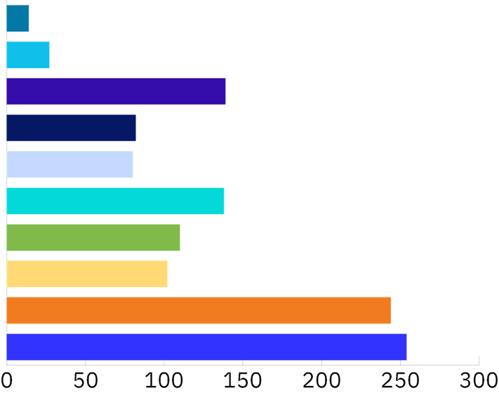
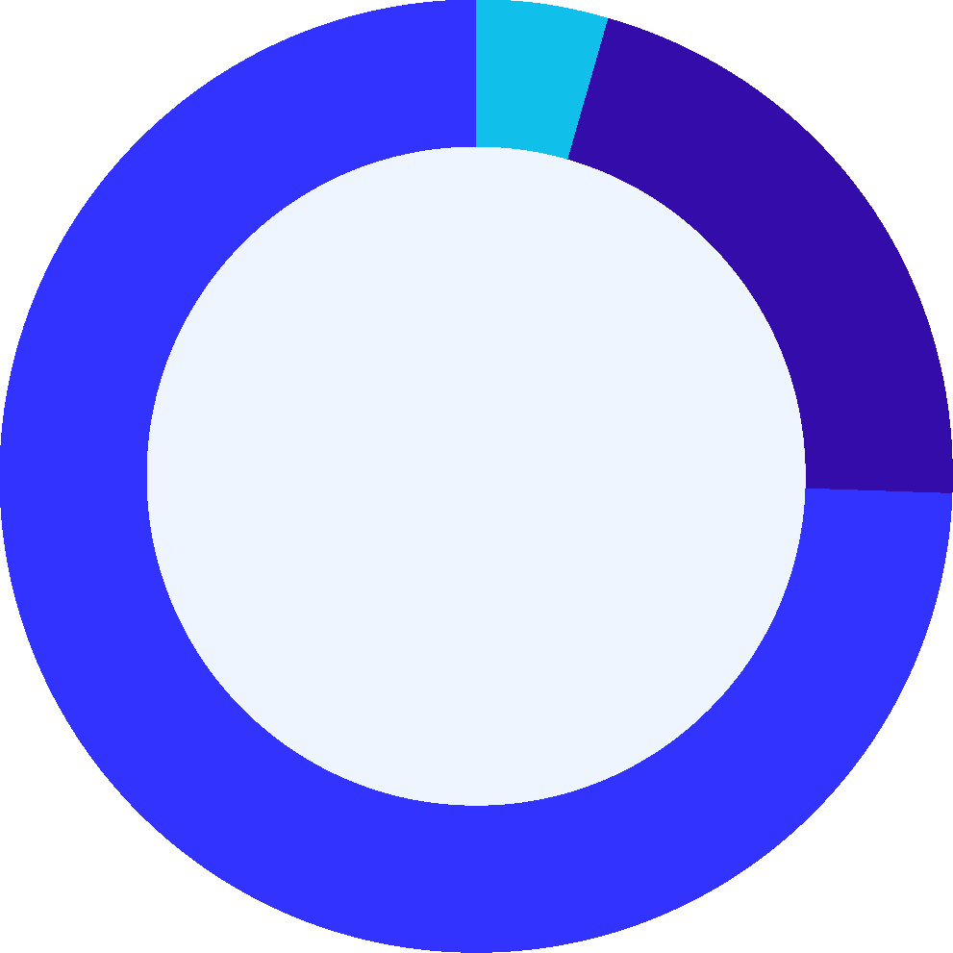
Who Attends?
Role Breakdown
33%
44%
23%
Sales
Pro Services
Corporate
1.2%
Northwest
Southwest
74% Specialist and Practitioners
2.3%
5% Senior Leadership (VP+)
11.7%
North Central
6.9%
Heartland
6.7%
Southeast
TOTAL 1190
11.6%
Mid-Atlantic
9.2%
Northeast
8.6%
Federal
Pro Services
21% Directors/Managers
20.5%
21.3%
Corporate
Copyright ©2025 | guidepointsecurity.com
13

Slide 14
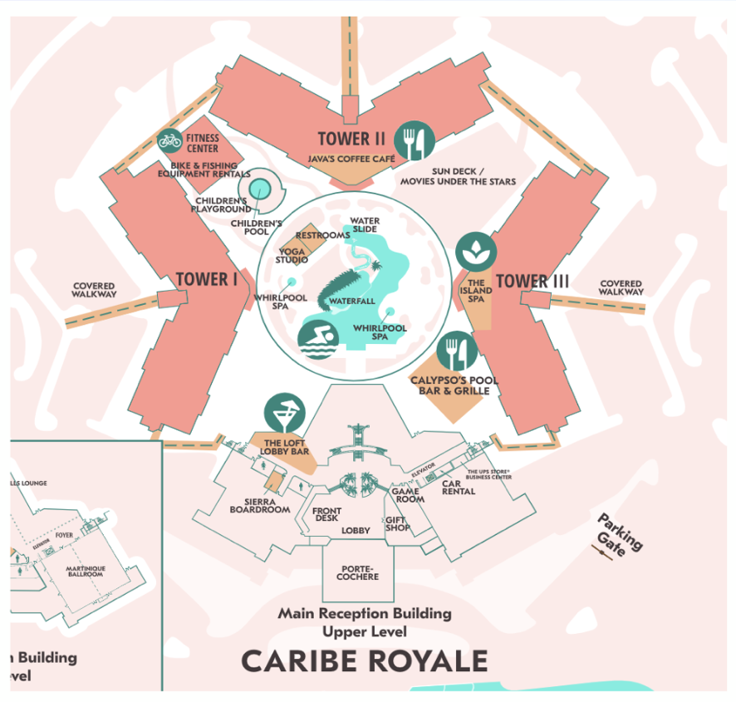
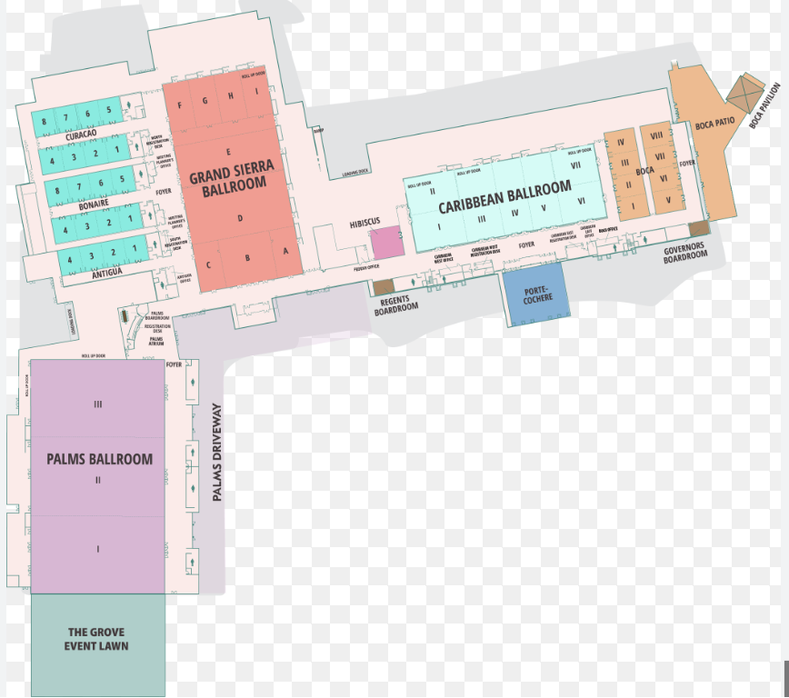
Caribe Royale | MAP
Notes:
Sponsor Showcase: Grand Sierra

Slide 15
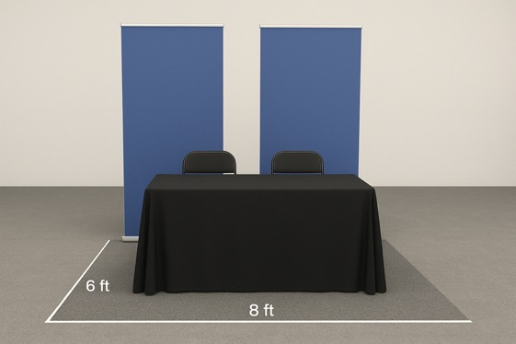

Sponsor Showcase Details
NEW DATE Tuesday, February 3 | Grand Sierra Ballroom
Showcase Set Up Hours: Set up 6:30am - 3:00pm
Sponsor Showcase: 3:30pm - 6:00pm
Sponsorship includes: One table, two chairs (no electrical)
Sponsors may bring: Table throws, banner stands, collateral, promo items, raffle prizes
Title Sponsor: 12’ X 12’ table
All Other Sponsorship Levels include: 6’ x 8’ footprint, one 6’ table, two chairs
300 swag items recommended
Sponsor to manage raffle prize and drawing - GPS to provide tickets and boxes
Table Assignments Sent: January 7th
Tear down and return shipping begins after 6:00 pm

Slide 16
Shipping Details
Advanced Warehouse Shipping Label Details:
Package Pickup:
All advanced warehouse shipped packages will be placed on your showcase table
Show Site shipped packages will need to be picked up at the FedEx office on-site at Caribe Royale
SDS WAREHOUSE
Attn: CKO / (Company Name)
4275 Arco Lane
Suite B
North Charleston, SC 29418
Return Shipments:
Your team should include return shipping labels in shipment
Leave LABELED & TAPED packages on your table
Anything not labeled will be thrown out
GPS not responsible for printing labels on-site
Shipment Window: Dec 8th - Jan 26th
NEW: Email CKOsponsors@guidepointsecurity.com Number of boxes shipped + tracking information

Slide 17
Late Shipping
Option
Late Arrivals:
Shipments past Jan 26th must be sent directly to Caribe Royale. All shipping and handling fees are at the Sponsor’s expense. Sponsors are responsible for pickup and placement.
Shipping Label Details:
Company name, C/O GPS CKO
FedEx Office at Caribe Royale Orlando
8101 World Center Dr.
Orlando, FL 32821

Slide 18

Raffle Prize Process
Raffle Details:
Sponsors will manage their raffle offering
Sponsors determine what to raffle and how many raffles you wish to provide
CKO Team will provide tickets and boxes to each sponsor table
GPS employee will put cell phone number on the ticket and place in the box
Sponsor will be responsible for drawing winners, notifying & delivering prize after showcase
Partners, VP and above level GPS employees are not eligible to win

Slide 19
Sponsor Tasks & Registration

Slide 20

Cvent Sponsor
Portal Tasks
All Portal Tasks Due: January 5th, 2026
Logo - due ASAP
Website URL
Company description
Shipping Label
Attendee Registration
Hotel Booking

Slide 21

CKO Sponsor Attendee Registration
Attendee Registration Deadline January 5th, 2026
Number of Attendee Passes
Title
12
Done by each individual attendee or completed on their behalf (each attendee must use unique email address, cannot be gmail)
Names can be changed up until January 30 - confirmation email
Link in CKO Sponsor Hub
Diamond
10
Platinum
8
Gold
6
Tiger Cage
6
Silver
3

Slide 22
Booking Hotel Rooms: January 5th Deadline
Completed after Attendee Registration
Done by each individual attendee
Available until sold out
Changes can be made via link in hotel confirmation email
Room Rate:
Caribe Royale Room Rate: $330 Per Room Night
Confirmation Email from info@cvent, not @guidepointsecurity
Extending your stay:
You can extend up to 3 days before or 3 days after (based on hotel availability)
Book during your hotel registration

Slide 23
Regional Outings - Survey Registration
Monday, February 4th
Title, Diamond, Platinum
  All Regional Events
  Two Attendees
Gold, Tiger Cage
  Two Events
  Two Attendees
Silver
  No participation
Selection Process: Gold and Tiger Cage:
Complete ranking process in Sponsor Portal by December 19th
Selections shared by January 5th
Attendee Outing registration by January 9th

Slide 24
Timeline & Deliverables
Deliverable
Deadline
Sponsor Level
Registration Opens
November 21st, 2025
All
Shipping Deadline
December 8th - January 26th
All
Logo Submission
December 15, 2025
All
Regional Outing Selections
Dec. 19th, 2025 Selections | Notified Jan. 5
Gold and Tiger Cage
All Sponsor Portal Tasks
January 5th, 2026
All
Registration Closes
January 5th, 2026
All
Table Assignments Sent
January 7th, 2026
All
Regional Outing Attendee Registration
January 9th, 2026
Title, Diamond, Platinum, Gold, Tiger Cage
Push Notifications Mobile App Content
January 9th, 2026
Title, Diamond
Copyright ©2025 | guidepointsecurity.com

Slide 25
Contact Information
Alex Iversen: Sponsorship Packages
alex.iversen@guidepointsecurity.com
Jessi McCubbin: Contracts and Invoicing
jessi.mccubbin@guidepointsecurity.com
Sponsor Logistics, Showcase, Shipping, Travel, Logos, etc
ckosponsors@guidepointsecurity.com
VRM Team: Executive Meetings
vrm@guidepointsecurity.com

Slide 26
Sponsor
Next Steps
Next Steps:
Complete Sponsor Portal Tasks
CKO Attendee Registration - can use placeholders
Book Hotel - can use placeholders
Showcase Shipping
Gold and Tiger Cage: Complete Regional Outing Selections

Slide 27
Frequently Asked Questions:
Can I change my attendees and hotel details?
Extra passes requests and billing? Cost?
How can I get a copy of my sponsorship details?
When is the registration deadline?
January 5, 2026
When is the hotel deadline?
January 5, 2026
Who do I contact when I am stuck?
ckosponsors@guidepointsecurity.com
What kind of prize should we provide for the Showcase?
How much swag should I send?
Enough for 300 people minimum
Can I have electricity at my Showcase table?
No
When is the next webinar?
KBYG late January

Slide 28
Questions?
CKOSPONSORS@GUIDEPOINTSECURITY.COM

